Slide 1

Microprocessor & Computer Architecture (μpCA)
UE23CS251B
Session - 4

Slide 2
Microprocessor & Computer Architecture (μpCA)
UE23CS251B
Data Processing Instructions

Slide 3
ARM Assembly Language Programming
ARM instructions are grouped as follows.
Data Processing Instructions.
Ex: MOV, ADD, SUB , CMP, CMN, etc.,
Branch Instructions.
Ex: B , BL, BGT, BLT, BGE, BLE, etc.,
Data Transfer Instructions.
Ex: LOAD – STORE Instructions- LDR, STR, LDM, STM, etc.,
Software Interrupt Instructions.
Ex: SWI Ox11, etc.,
Program Status Register Instructions.
Ex: MSR , MRS, etc.,

Slide 4
ARM Assembly Language Programming
ARM instructions are grouped as follows.
Data Processing Instructions.
Ex: MOV, ADD, SUB , CMP, CMN, etc.,
Branch Instructions.
Ex: B , BL, BGT, BLT, BGE, BLE, etc.,
Data Transfer Instructions.
Ex: LOAD – STORE Instructions- LDR, STR, LDM, STM, etc.,
Software Interrupt Instructions.
Ex: SWI Ox11, etc.,
Program Status Register Instructions.
Ex: MSR , MRS, etc.,

Slide 5
ARM Instruction Set
Data Processing Instructions.
MOVE instruction
Syntax: <mnemonic><cond><s> <dest Rd>, <src op1 Rn>
Ex1: MOV R0 , R1
R0 🡨 R1
Moves the contents of the source operand registers R1 and copies to the destination register R0.
Ex2: MVN R0, R1
R0 🡨 negate( R1)
Moves the complemented value of the source operand register R1 and stores to the destination register R0.

Slide 6
ARM Instruction Set
Arithmetic Instruction:
Syntax: <mnemonic><cond><s> <dest Rd>, <src op1 Rn >, <src op2 Rm>
Ex3: ADD R3, R1, R2
R3 🡨 R1 + R2
Adds the contents of the source operand registers R1 & R2 and stores the result in the destination register R3.
Compare Instruction:
Syntax:
<mnemonic><cond><s> <dest Rd>, <src op1 Rn >,
Ex4: CMP R3, R1
Neither source nor destination fields are affected.
Ex4: CMN R3, R1
Performs the operation R3 + R1 and sets the condition codes / flags.
Neither source nor destination fields are affected.

Slide 7
Setting the condition codes
Any data processing instruction can set the condition codes if the programmers wish it to
64-bit addition
ADDS R2, R2, R0
ADC R3, R3, R1

Slide 8
Comparison
CMP R1, R2 @ set cc on R1-R2
CMN R1, R2 @ set cc on R1+R2
TST R1, R2 @ set cc on R1 and R2
TEQ R1, R2 @ set cc on R1 xor R2
compare
compare negated
bit test
test equal

Slide 9
Arithmetic Operations
MOV R4, #10
MVN R5, R4
MOV R1, #5
MOV R2, #2
ADD r0, r1, r2 ;r0:=r1+r2
ADC r0, r1, r2 ;r0:=r1+r2+C
SUB r0, r1, r2 ;r0:=r1–r2
SBC r0, r1, r2 ;r0:=r1–r2+C–1
RSB r0, r1, r2 ;r0:=r2–r1, Reverse Subtraction
RSC r0, r1, r2 ;r0:=r2–r1+C–1
By default data processing operations do not affect the condition flags

Slide 10
Bit-wise Logical Operations
AND r0, r1, r2 ;r0 := r1 AND r2
ORR r0, r1, r2 ;r0 := r1 OR r2
EOR r0, r1, r2 ;r0 := r1 XOR r2
BIC r0, r1, r2 ;r0 := r1 AND (NOT r2), bit clear

Slide 11
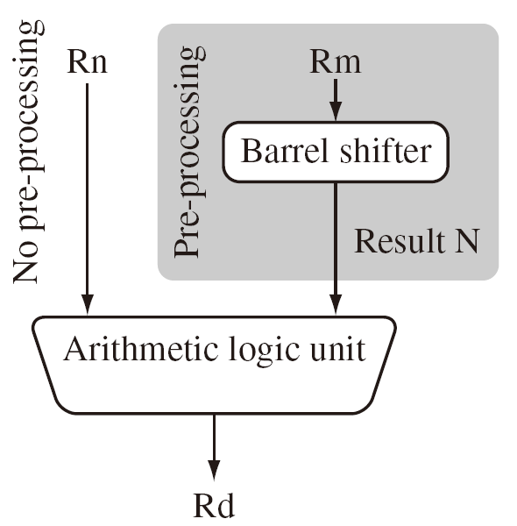
Shifted register operands
One operand to ALU is routed through the Barrel shifter. Thus, the operand can be modified before it is used. Useful for fast multiplication and dealing with lists, table and other complex data structure. (similar to the displacement addressing mode in CISC.)
Some instructions (e.g. MUL, CLZ, QADD) do not read barrel shifter.

Slide 12
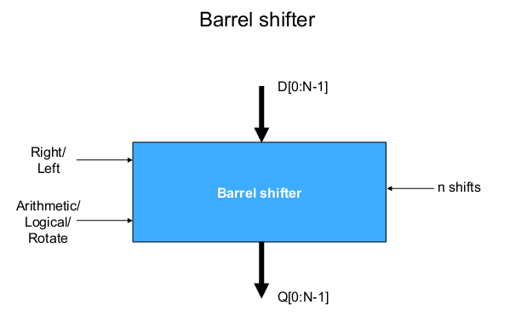
Barrel Shifter - Block Diagram

Slide 13
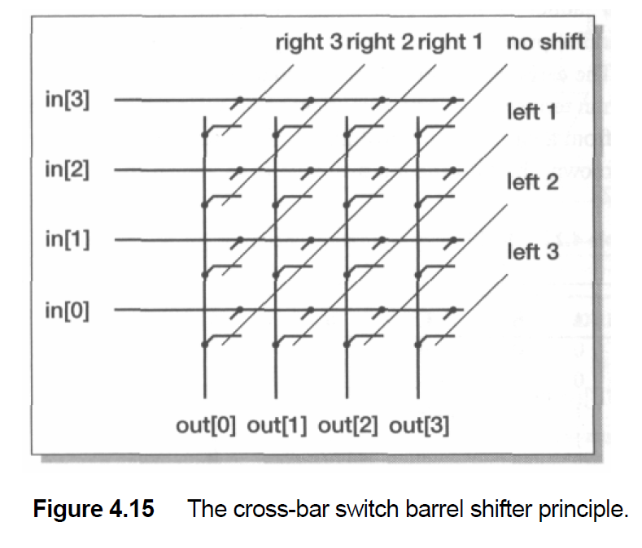
Barrel Shifter
ARM architecture supports instructions which performs a shift with ALU operation.
The shifter performance is therefore critical as it contributes directly to the datapath cycle time.
To minimize the delay through the shifter, A cross-bar switch matrix is used to steer each input to appropriate output.
Example shown is 4 x 4 matrix cross bar switch.
ARM uses a 32 x 32 matrix cross bar switch.
Each input is connected to each output through a switch.

Slide 14
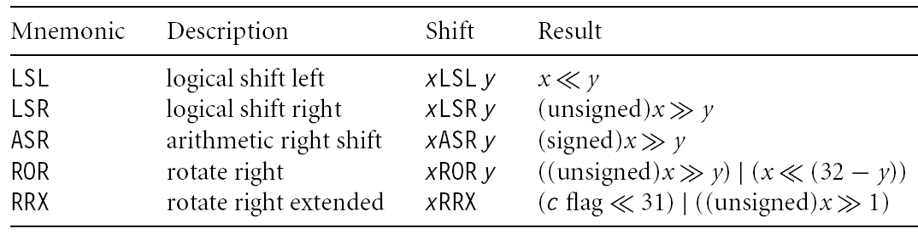
Barrel Shifter - Function
Shift Operation – Left
One left shift diagonal line is turned on.
Shift Operation – Right
One right shift diagonal line is turned on.
Arithmetic Shift right
Uses sign extension rather than zero filling for unconnected output.
Rotate operation
The right shift diagonal is enabled together with complementary left shift diagonal.

Slide 15
Multiplication by constant using the barrel shifter
Multiplication by 2^n (1,2,4,8,16,32..)
MOV Ra, Rb, LSL #n
Multiplication by 2^n+1 (3,5,9,17..)
ADD Ra,Ra,Ra,LSL #n
Multiplication by 2^n-1 (3,7,15..)
RSB Ra,Ra,Ra,LSL #n
Multiplication by 6
ADD Ra,Ra,Ra,LSL #1 ; multiply by 3
MOV Ra,Ra,LSL#1 ; and then by 2
Multiply by 10 and add in extra number
ADD Ra,Ra,Ra,LSL#2 ; multiply by 5
ADD Ra,Rc,Ra,LSL#1 ; multiply by 2 and add in next digit

Slide 16
Barrel Shifter - Examples
Shift Operation – Left
One left shift diagonal line is turned on.
Example 1: ADD R0, R1, R2, LSL #3
Since LSL is used, it selects left diagonal #3.
Rotate operation
The right shift diagonal is enabled together with complementary left shift diagonal.
Example 2: ADD R0, R1, R2, ROR #3
Selects Right diagonal #3 and left diagonal # 29.

Slide 17
Logical shift left
C
register
0
MOV R0, R2, LSL #2 @ R0:=R2<<2
@ R2 unchanged
Example: 0…0 0011 0000
Before R2=0x00000030
After R0=0x000000C0
R2=0x00000030

Slide 18
Logical shift right
0
register
C
MOV R0, R2, LSR #2 @ R0:=R2>>2
@ R2 unchanged
Example: 0…0 0011 0000
Before R2=0x00000030
After R0=0x0000000C
R2=0x00000030

Slide 19
Arithmetic shift right
MSB
register
C
MOV R0, R2, ASR #2 @ R0:=R2>>2
@ R2 unchanged
Example: 1010 0…0 0011 0000
Before R2=0xA0000030
After R0=0xE800000C
R2=0xA0000030

Slide 20
Rotate right
register
MOV R0, R2, ROR #2 @ R0:=R2 rotate
@ R2 unchanged
Example: 0…0 0011 0001
Before R2=0x00000031
After R0=0x4000000C
R2=0x00000031

Slide 21
Rotate right extended
C
register
C
MOV R0, R2, RRX @ R0:=R2 rotate
@ R2 unchanged
Example: 0…0 0011 0001
Before R2=0x00000031, C=1
After R0=0x80000018, C=1
R2=0x00000031

Slide 22
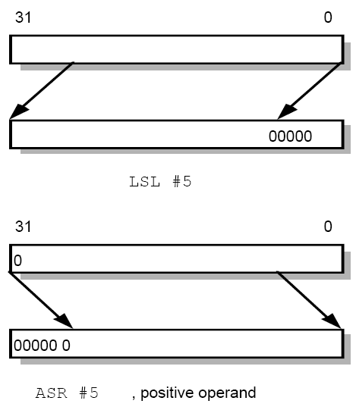
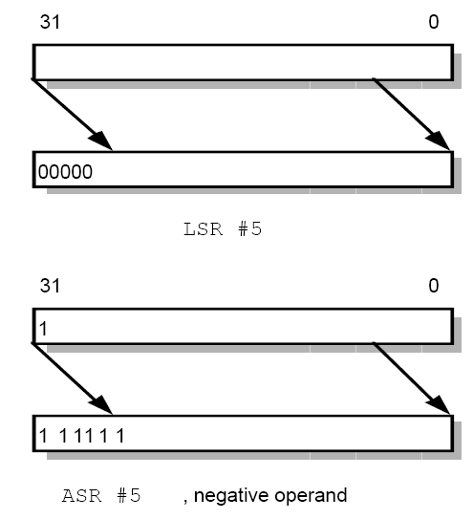
Shifted register operands

Slide 23
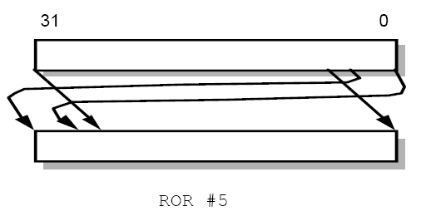
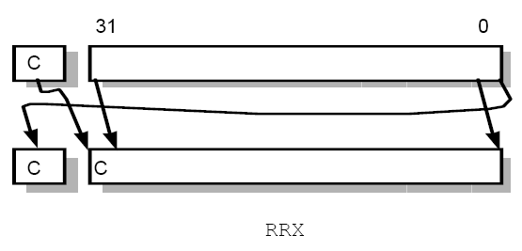
Shifted register operands

Slide 24
Shifted register operands
It is possible to use a register to specify the number of bits to be shifted; only the bottom 8 bits of the register are significant.
@ array index calculation
ADD R0, R1, R2, LSL R3 @ R0:=R1+R2*2^{R3}
@ fast multiply R2=35xR0
ADD R0, R0, R0, LSL #2 @ R0’=5xR0
RSB R2, R0, R0, LSL #3 @ R2 =7xR0’

Slide 25
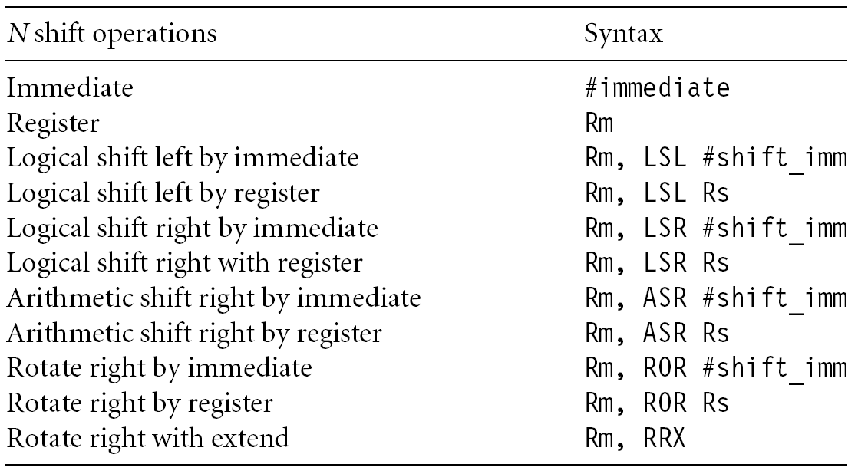
Shifted register operands

Slide 26
Multiplication as Addition & Subtraction
MOV R1, #35
MUL R2, R0, R1
or
ADD R0, R0, R0, LSL #2 @ R0’=5xR0
RSB R2, R0, R0, LSL #3 @ R2 =7xR0’

Slide 27

Arm Instruction Set – data processing group

Slide 28
ARM Instruction Set
Using the ARM instruction set, write Assembly level language instructions / sequence /programs
to perform the following as directed.
Compile the following C assignment statements into ARM.
A = B + C;
D = A – C;
Perform D = A - C using RSB instruction.
Convert the following assignment into ARM.
F = ( G + H ) – ( I + J ).
use the register R0 to R4 as operands F to J respectively.
Convert the statement into ARM where the operand is in memory.
G = H + A [ 10 ].
Assignment.
Note: User different addressing modes both at source & destination operand positions.

Slide 29

THANK YOU
Team MPCA
Department of Computer Science and Engineering

